Slide 1
FAST and IMAGE Coincident Viewing
11/17/16 Tagup

Slide 2
Ephem Status
FAST definitive Ephem provided by R. Strangeway
Time span: 1996 234 10:30:00.000 to 2009 121 02:26:49.990
SMA = 8300, ECC = 0.1898; INC = 82.97 (all the rest variable)
Inertial nodal regression rate = -0.5 deg/day; solar apparent motion 0.986 deg/day; movement in SM Local Time ~1.5 deg/day
IMAGE definitive Ephem constructed piece-wise from data obtained from CDAWeb (http://cdaweb.sci.gsfc.nasa.gov/cgi-bin/eval2.cgi)
Time span: 3/27/2000 00:00:55.000 to 12/19/2005 23:58:00.000
SMA = 29,815.4; ECC = 0.7531; INC = 90.010 (all the rest variable)

Slide 3

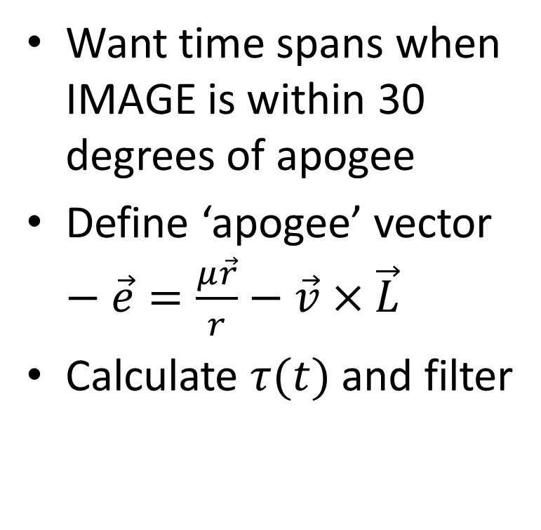




IMAGE Epoch Filtering Strategy
Want time spans when IMAGE is within 30 degrees of apogee
Define ‘apogee’ vector $−\vec{e}=\frac{μ\vec{r}}{r}−\vec{v}×\vec{L}$
Calculate $τ(t)$ and filter
$$−\vec{e}$$
$τ$ – angle between $−\hat{e}$ and $\vec{r}$
$$\vec{r}$$
$$τ$$
IMAGE Orbit

Slide 4

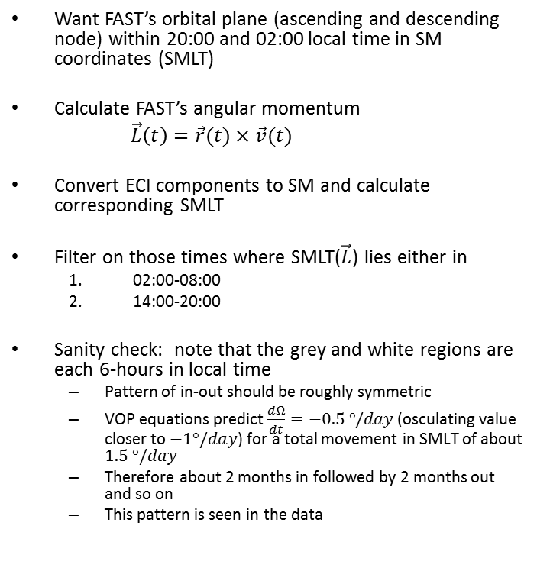



FAST Epoch Filtering Strategy
FAST Orbit
Want FAST’s orbital plane (ascending and descending node) within 20:00 and 02:00 local time in SM coordinates (SMLT)
Calculate FAST’s angular momentum
$\vec{L}\left(t\right)=\vec{r}(t)×\vec{v}(t)$
Convert ECI components to SM and calculate corresponding SMLT
Filter on those times where SMLT($\vec{L}$) lies either in
02:00-08:00
14:00-20:00
Sanity check: note that the grey and white regions are each 6-hours in local time
Pattern of in-out should be roughly symmetric
VOP equations predict $\frac{dΩ}{dt}=−0.5 °/day$ (osculating value closer to $−1°/day$) for a total movement in SMLT of about $1.5 °/day$
Therefore about 2 months in followed by 2 months out and so on
This pattern is seen in the data
Sun
$$\vec{L}$$
$$\vec{L}$$
08:00
12:00
02:00
$${\hat{x}}_{SM}$$
(sunward)
14:00
20:00
$${\hat{y}}_{SM}$$

Slide 5

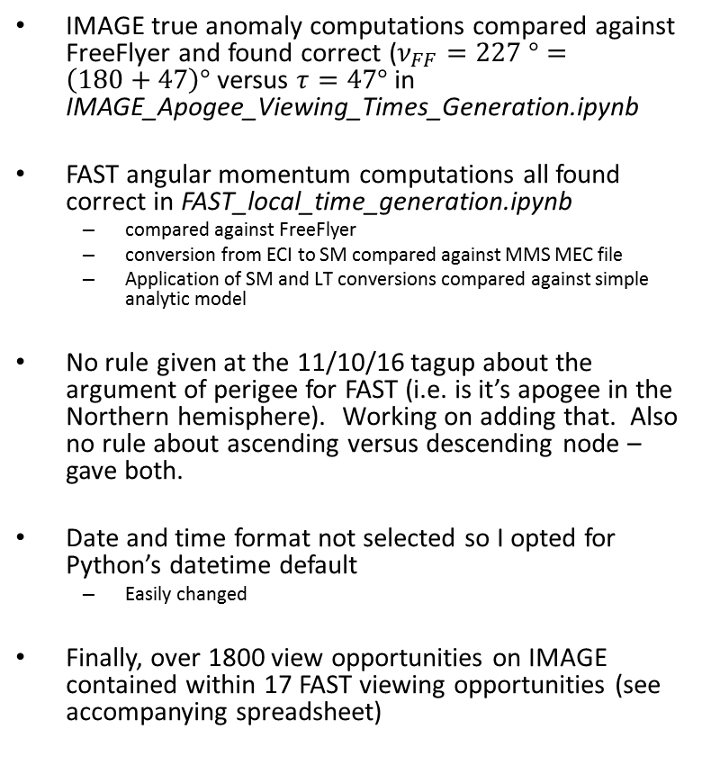

Other Sanity Checks and Other Considerations
IMAGE true anomaly computations compared against FreeFlyer and found correct ($ν_{FF}=227 °=\left(180+47\right)°$ versus $τ=47°$ in IMAGE_Apogee_Viewing_Times_Generation.ipynb
FAST angular momentum computations all found correct in FAST_local_time_generation.ipynb
compared against FreeFlyer
conversion from ECI to SM compared against MMS MEC file
Application of SM and LT conversions compared against simple analytic model
No rule given at the 11/10/16 tagup about the argument of perigee for FAST (i.e. is it’s apogee in the Northern hemisphere). Working on adding that. Also no rule about ascending versus descending node – gave both.
Date and time format not selected so I opted for Python’s datetime default
Easily changed
Finally, over 1800 view opportunities on IMAGE contained within 17 FAST viewing opportunities (see accompanying spreadsheet)
$$−\vec{e}$$
$$τ$$
$τ$ – angle between $−\hat{e}$ and $\vec{r}$
$$\vec{r}$$
IMAGE Orbit

